Slide 1


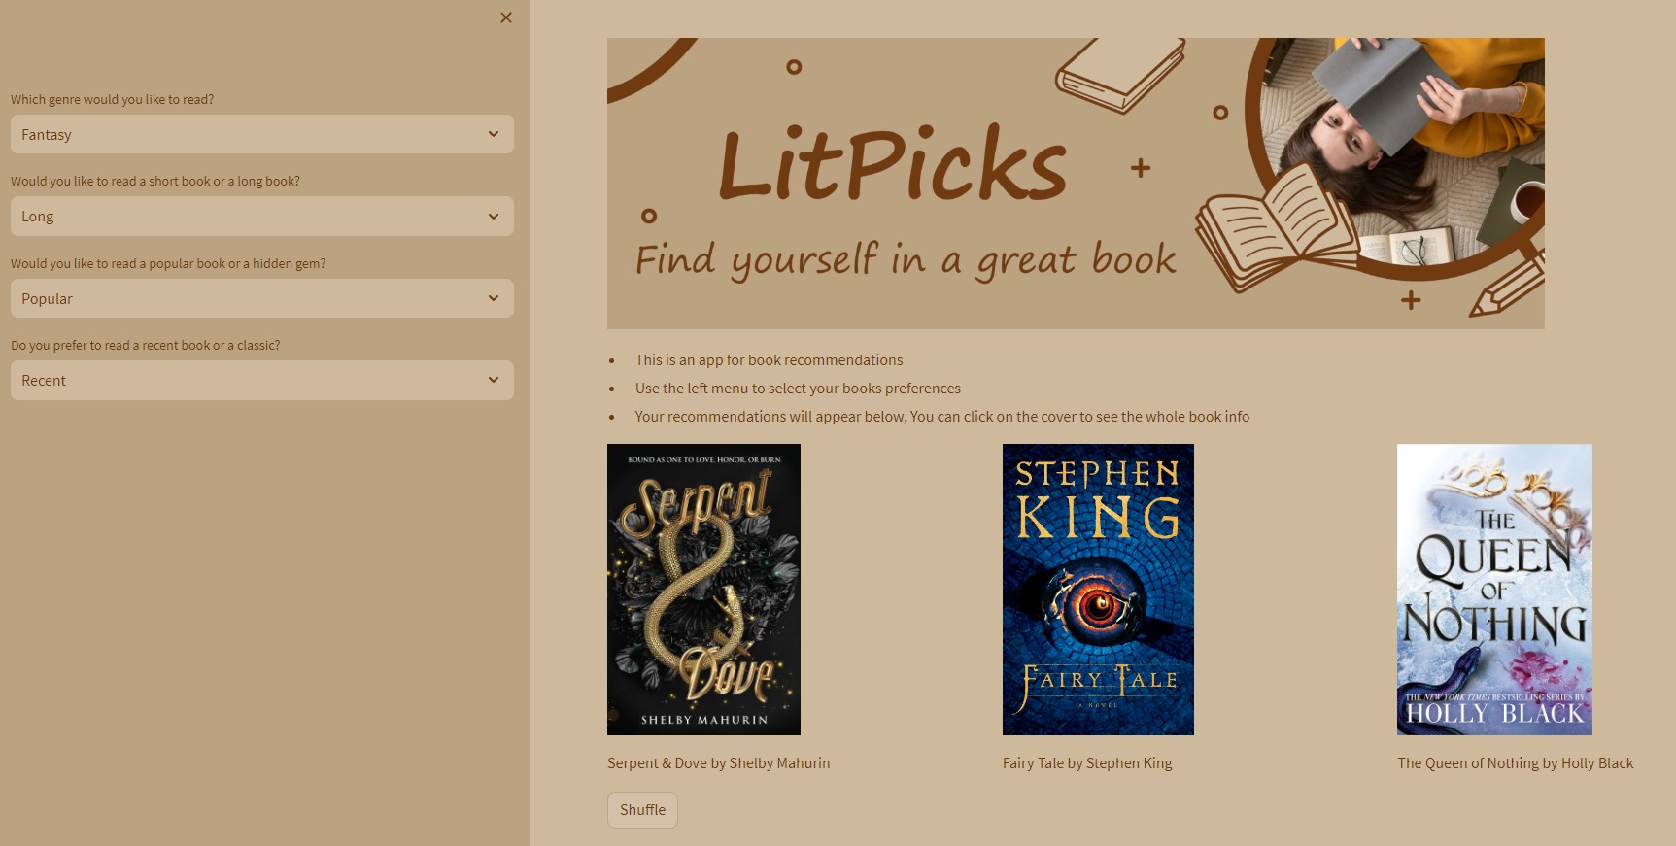
LitPicks
Welcome to LitPicks, the final project for the Data Analytics Bootcamp. This app is designed to help users discover their next great read by providing personalized book recommendations based on their preferences. The app utilizes web scraping, data cleaning, and Streamlit for the user interface.
Margarita Montenegro Villalba
july 2023

Slide 2





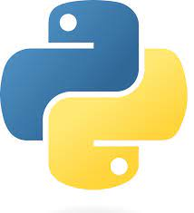

Technology Stack

Slide 3
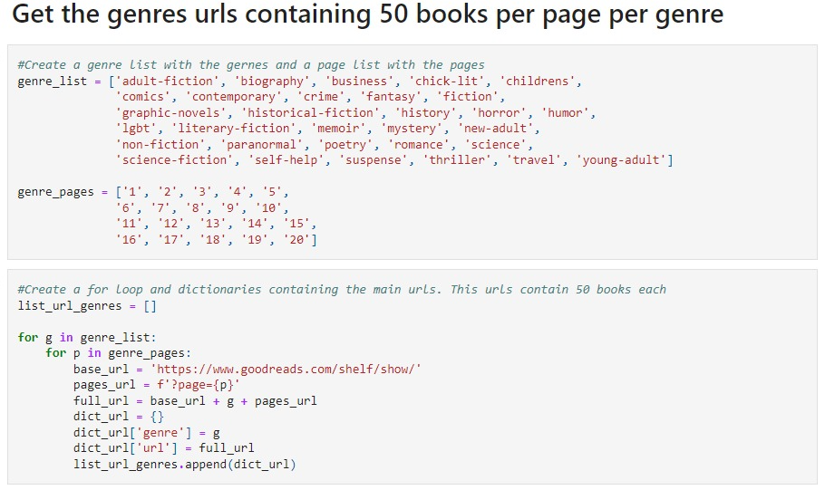
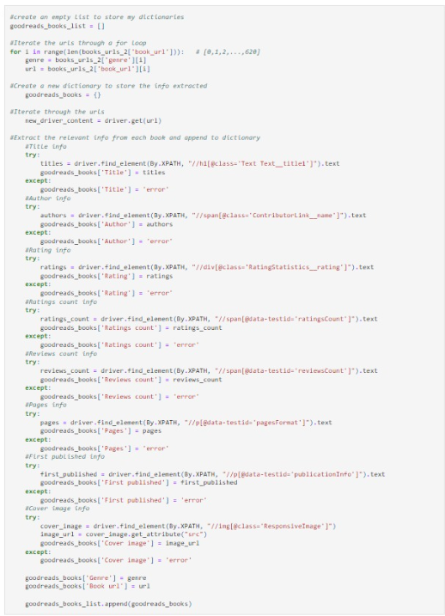
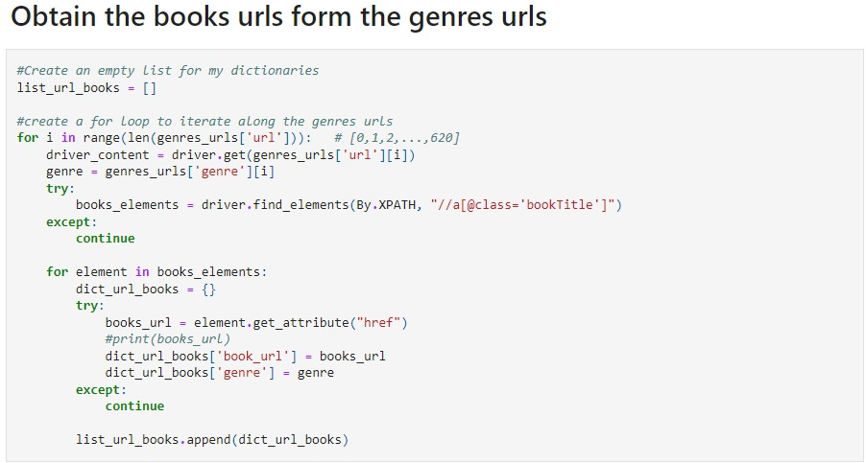
Data Adquisition
To create a diverse and extensive collection of books, I performed web scraping using Selenium from Goodreads. The scraping process covered 31 genres, gathering data on 1,000 books per genre, resulting in a total of 31,000 books.
This part of the code took 27 hours to run

Slide 4
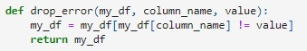
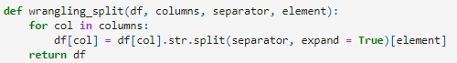
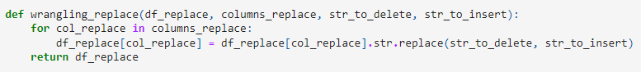
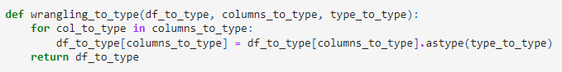
Data Cleaning
Steps taken during the data cleaning phase include:
Handling numerical data: Ensuring all numerical data were correctly represented as integers or floats instead of objects.
Error elimination: Removing rows with data errors or missing values to maintain data integrity

Slide 5
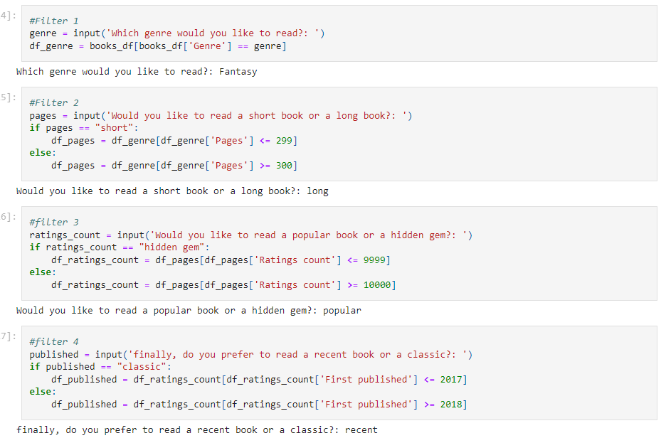
App Development
I initially tested the app's functionality in Jupyter Notebook before implementing it in the main.py file.

Slide 6
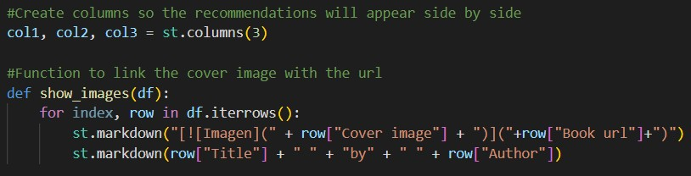
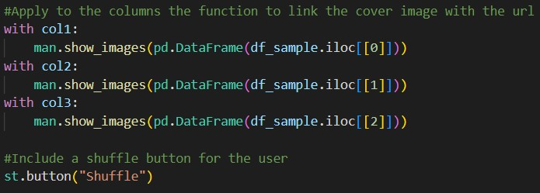
Implementing Streamlit
After applying the desired filters, the app presents the user with three book choices. Users can click on a cover to be redirected to the book's Goodreads page for more information.
If the user isn't satisfied with the initial recommendations, they can shuffle the book options to receive a new set of choices.

Slide 7
Conclusion
LitPick aims to make the book selection process more
enjoyable and personalized for readers. By combining
web scraping, data cleaning, and Streamlit, this
project offers an interactive platform for discovering
new and exciting reads. Feel free to explore the app,
discover new books, and embark on captivating
literary journeys!

